Slide 1

</>
Real Estate Management System

Slide 2
</>
SOFTWARE QUALITY ASSURANCE AND TESTING
TEAM MEMBERS
HUMAYUN SAEED
ABDULRAHMAN KHATIB
22118437
21906563

Slide 3
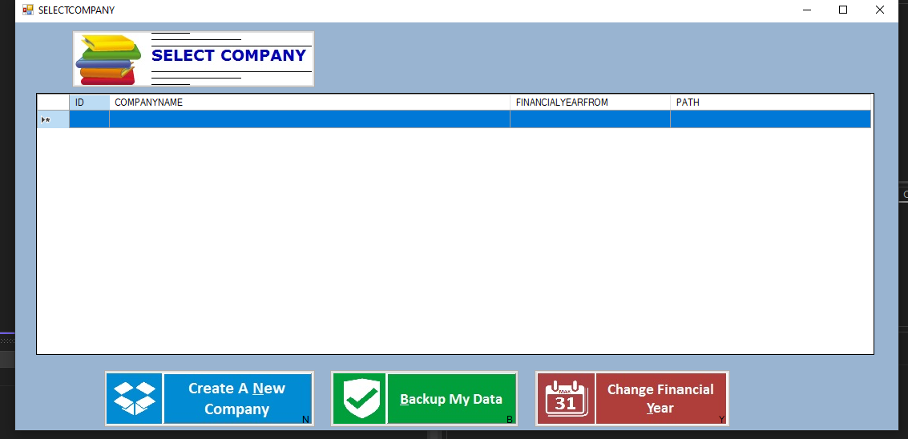
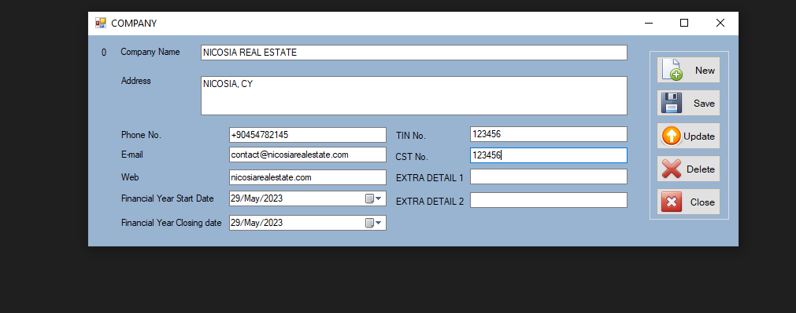

Slide 4
What are we Going to Talk About Today ?
Testing Approach
Testing Tools and CheckLists
Test Results

Slide 5
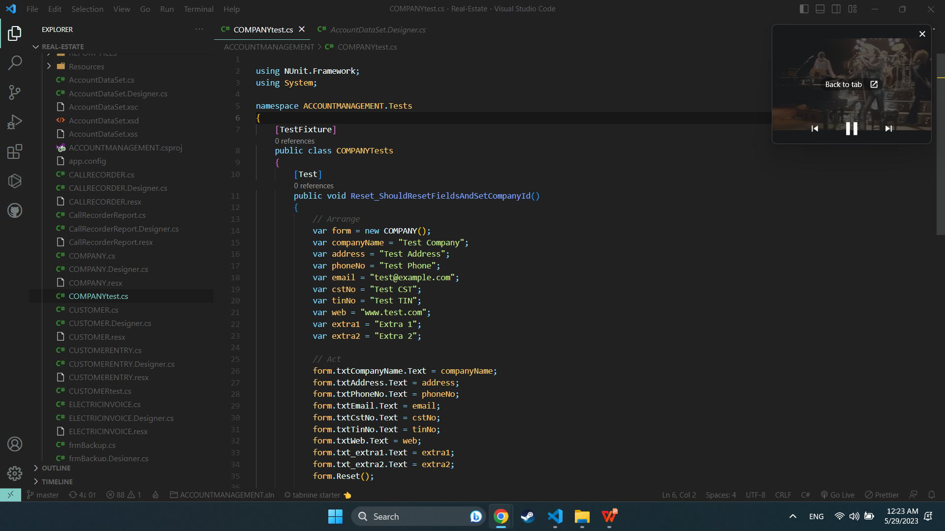
</>
Testing Approach
Testing Methodology: Unit Testing
Definition: Unit testing focuses on testing individual components or units of the application to ensure their functionality and correctness.

Slide 6
</>
Testing Approach
Testing Process:
Test Planning: We defined the objectives, scope, and criteria for our unit testing efforts.
Test Case Creation: We created detailed test cases to cover different functionalities of the application.
Test Execution: We systematically executed the test cases, recording actual results.
Defect Tracking: We logged and prioritized any issues or defects found during testing.

Slide 7
</>
Testing Results
Summary of Test Results:
Units Tested: 54
Key Functionalities Covered:
Keyboard input validation
Error handling and messaging
User interface responsiveness
Installation and uninstallation processes

Slide 8
</>
Testing Results
Defects and Issues:
Number of Issues Found: 5
Impact on Application:
2 critical defects affecting application stability
3 minor defects affecting user experience

Slide 9
</>
Testing Results
Actions Taken:
Critical Defects:
Assigned high priority and resolved immediately
Conducted thorough root cause analysis and implemented appropriate fixes
Retested the affected units to ensure the resolution
Minor Defects:
Prioritized based on impact and fixed during subsequent iterations
Conducted regression testing to ensure fixes didn't introduce new issues

Slide 10
</>
Testing Tools and Checklists
Testing Checklists Used:
Application Testing Checklist: Used to verify the application's primary functionality and stability.
Check-list Template: Customizable template for creating comprehensive checklists.
Quality Assurance Checklist: Ensures adherence to quality standards throughout the testing process.
Unit and Integration Plan Checklist: Helps plan and track unit and integration testing activities.
Purpose of Checklists: These checklists ensured thorough coverage of testing scenarios and aided in maintaining consistency and completeness in our testing efforts.

Slide 11
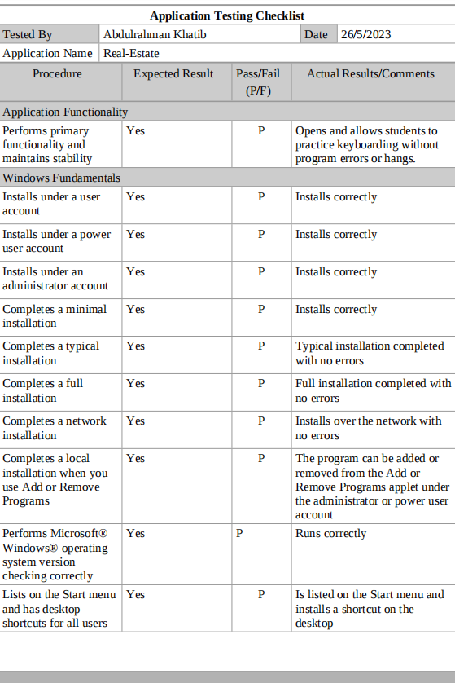
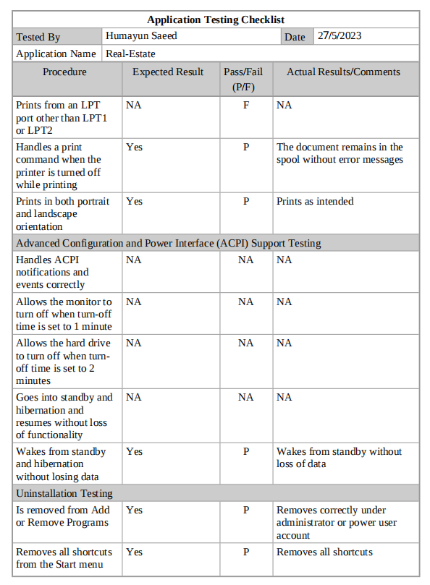
</>

Slide 12
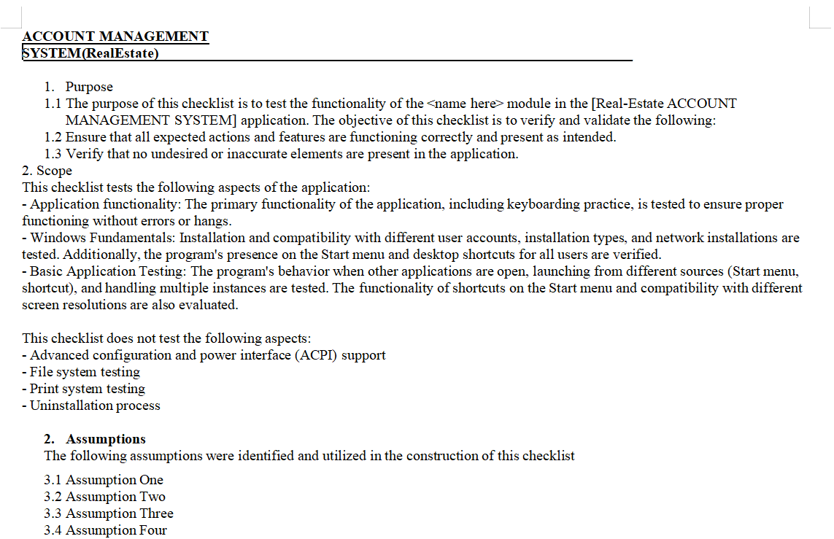
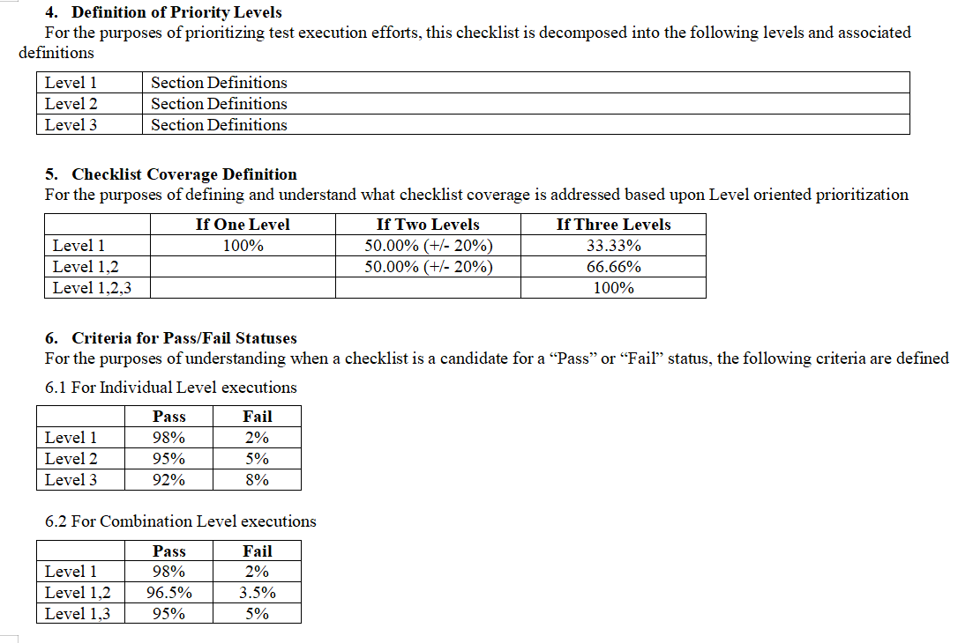
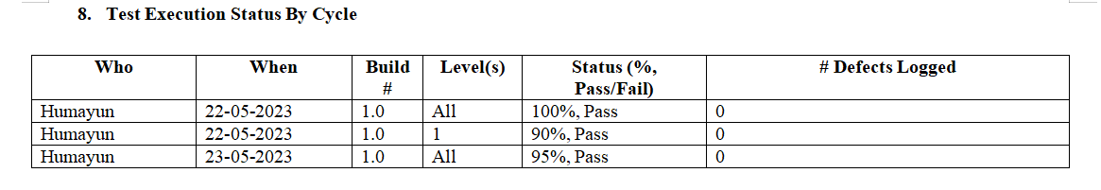

Slide 13
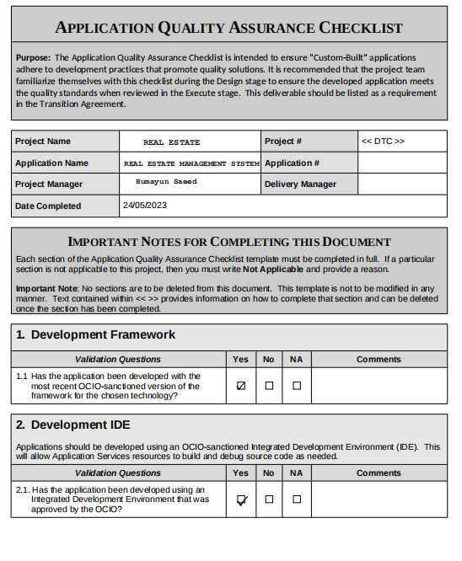
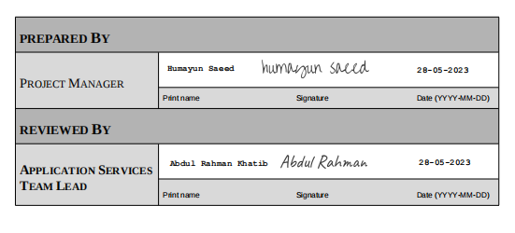

Slide 14
</>
THANK YOU FOR LISTENING !
ANY QUESTIONS ?

